Slide 1

E-Governance: Models and Components
Team Members List
  Naman Sagar (23/MC/093)
  Navdeep Singh (23/MC/094)
  Krish (23/MC/076)
  Lokesh Godara (23/MC/082)
  Parth Malik (23/MC/101)
  Madhav Gandhi (23/MC/083)

Slide 2
Introduction to E-Governance
Foundations and Scope of Digital Government Services
E-Governance refers to the digital transformation of government services, enhancing interactions between citizens and the government. This shift improves efficiency and accessibility, paving the way for modern governance.

Slide 3
Importance of E-Governance
Enhancing Efficiency and Accountability in Governance
Transparency
Accountability
E-Governance fosters transparency by enabling citizens to access government information easily, promoting open communication and trust between public officials and the community.
Through digital platforms, E-Governance ensures accountability, allowing citizens to track governmental actions and decisions, enhancing their engagement and encouraging responsible governance.

Slide 4
Broadcasting Model
One-Way Information Dissemination to Citizens
  This involves the transfer of information from government to citizens without seeking feedback.
  An example of this is the announcements made through the MyGov platform.
  This approach empowers citizens by providing them with essential information.
  The importance of transparency and clarity in communication. While one-way dissemination ensures that citizens receive timely updates
  It may lack the opportunity for public engagement and participation.

Slide 5
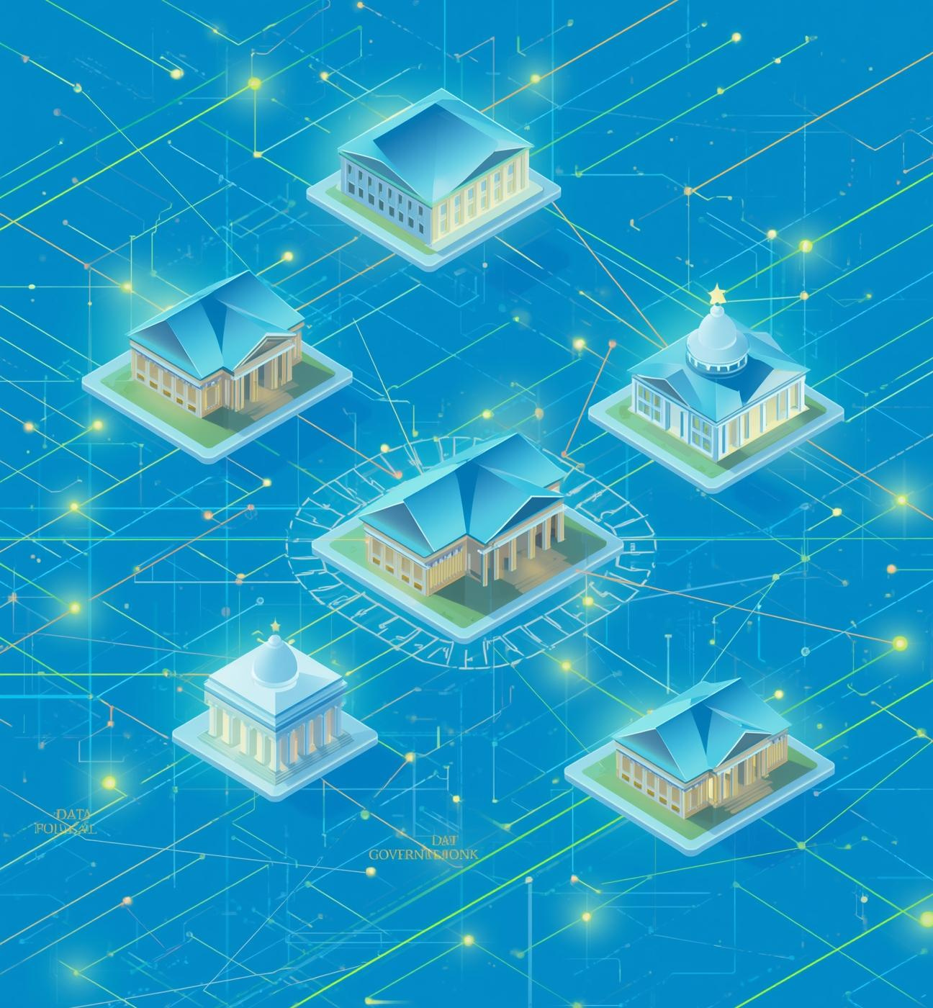
Critical Flow Model
  Definition: Controlled, secure information flow between government entities.
  Purpose: Ensures confidentiality and integrity of sensitive data.
  Use Cases: Inter-agency communication, secure data transfers, and crisis management.
  Examples: Health department data sharing during emergencies.

Slide 6
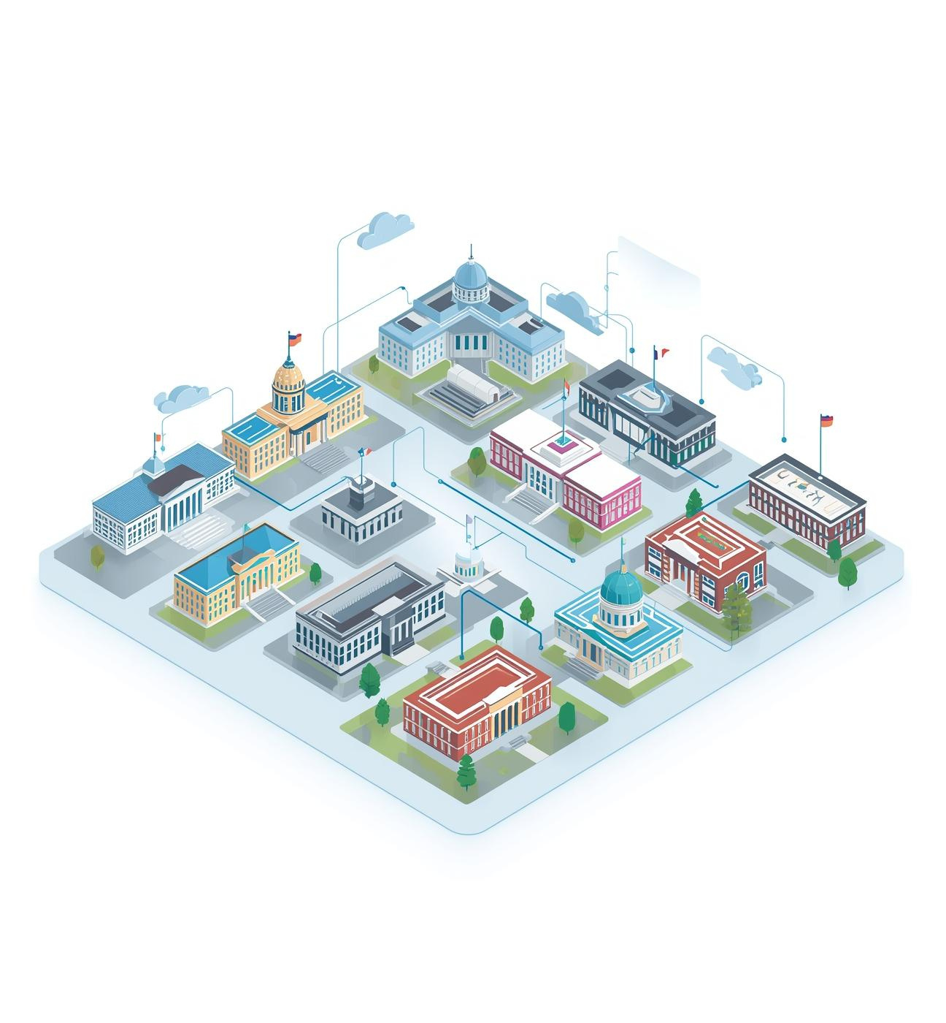
Comparative Analysis
  Definition: Benchmarking and comparing government performances across various services.
  Purpose: Assess effectiveness and efficiency of E-Governance initiatives.
  Use Cases: Performance metrics, public service delivery comparisons, and citizen satisfaction ratings.
  Example: Cross-country analysis of digital service accessibility.

Slide 7

E-Advocacy
  Engages citizens through digital platforms
  Facilitates advocacy campaigns and civic initiatives
  Empowers individuals to voice opinions and influence policies
  Enhances transparency and accountability in governance
  Encourages collaboration between government and citizens

Slide 8


Interaction Types
G2C
G2B
G2G
G2E
Government services to citizens
Regulations and support for businesses
Data sharing between government agencies
Internal HR services for employees

Slide 9
Four Interaction Types
Objectives and Transactions in E-Governance
G2C Interaction
G2B Interaction
Government to Citizen (G2C) interactions focus on delivering services and communication directly to the public, enhancing engagement through online portals and streamlined processes for citizen queries and access.
Government to Business (G2B) interactions involve providing regulatory information, licensing, and business support services, enabling easier compliance and fostering a supportive environment for entrepreneurs and businesses.

Slide 10
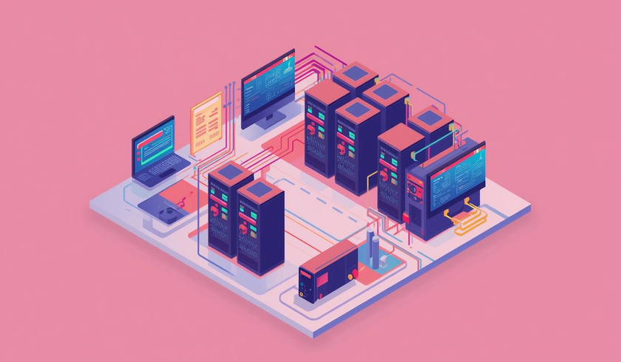
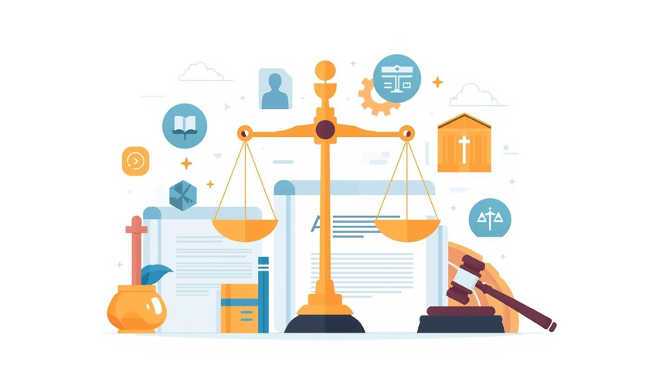
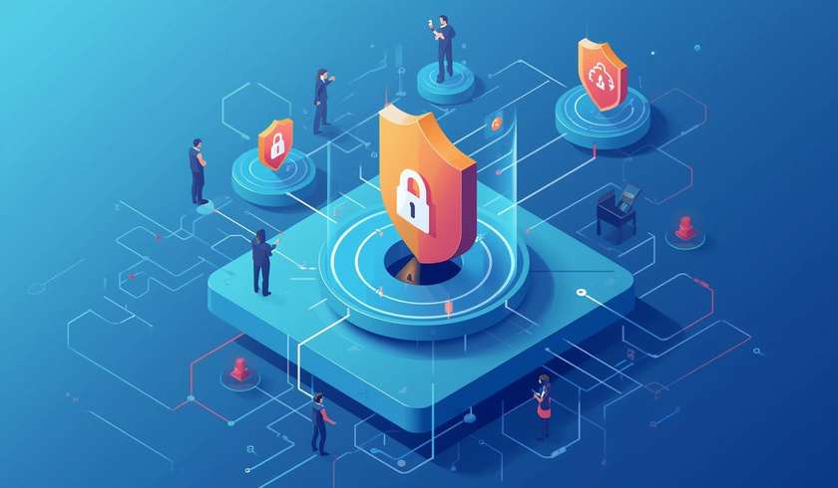
Core Components of E-Governance Explained
ICT Infrastructure
Legal Frameworks
Security Measures
Networks and systems enabling digital services
Regulations guiding E-Governance operations
Protecting data integrity and privacy

Slide 11
Core Components
Importance and Best Practices in E-Governance
Role and Importance
Challenges and Best Practices
The ICT infrastructure is vital as it enables efficient digital governance, supporting seamless interactions between government and citizens while fostering transparency and accessibility across services.
Legal and policy frameworks face challenges in adapting to rapid technological changes. Implementing best practices like regular updates ensures effective governance, data protection, and public trust in digital services.

Slide 12
Core Components
Key Elements of E-Governance Structure
Data Protection Laws
Secure Communication
Data protection laws ensure the safeguarding of personal information, establishing clear guidelines for data handling and privacy, which is vital for maintaining citizen trust in digital governance.
Implementing secure communication protocols protects sensitive information transmitted between government entities and citizens, enhancing overall security and preventing unauthorized access to vital data.

Slide 13
Notable Real-World Examples of E-Governance
India's Digital India initiative
Estonia’s innovative e-Residency program
Bridging technology and citizen engagement

